Slide 1
Earth Observation Big Data exploitation for water reservoirs continuous monitoring:
feasibility of a prototypal service based on Sentinel data and HPC
HPC4RM - ESA Living Planet 2022 - 26/05/2022
R. Ravanelli, V. Belloni, F. Bocchino, F. Gerace, P. Mazzucchelli, C. Arlandini, A. Fiorini, M. Crespi

Slide 2
Summary
Introduction
HPC4RM project
Methodology
Case studies
First results
Conclusions and outlook
HPC4RM - ESA Living Planet 2022
Earth Observation Big Data exploitation for water reservoirs continuous monitoring: feasibility of a prototypal service based on Sentinel data and HPC

Slide 3
Introduction
Water reservoirs are essential for freshwater supply and hydroelectric power production
Sustainable management of water reservoirs is crucial to monitor hydrological stresses and predict water availability
Water levels are usually monitored locally through traditional ground methods (e.g. gauge stations) by a variety of administrations or companies
The water level measurements collected by gauge stations are generally used together with morphological information (contour lines) to compute the water volume variation of the reservoir under investigation
Data from gauge stations are not always easily available and require direct access to the reservoir
HPC4RM - ESA Living Planet 2022
Earth Observation Big Data exploitation for water reservoirs continuous monitoring: feasibility of a prototypal service based on Sentinel data and HPC

Slide 4
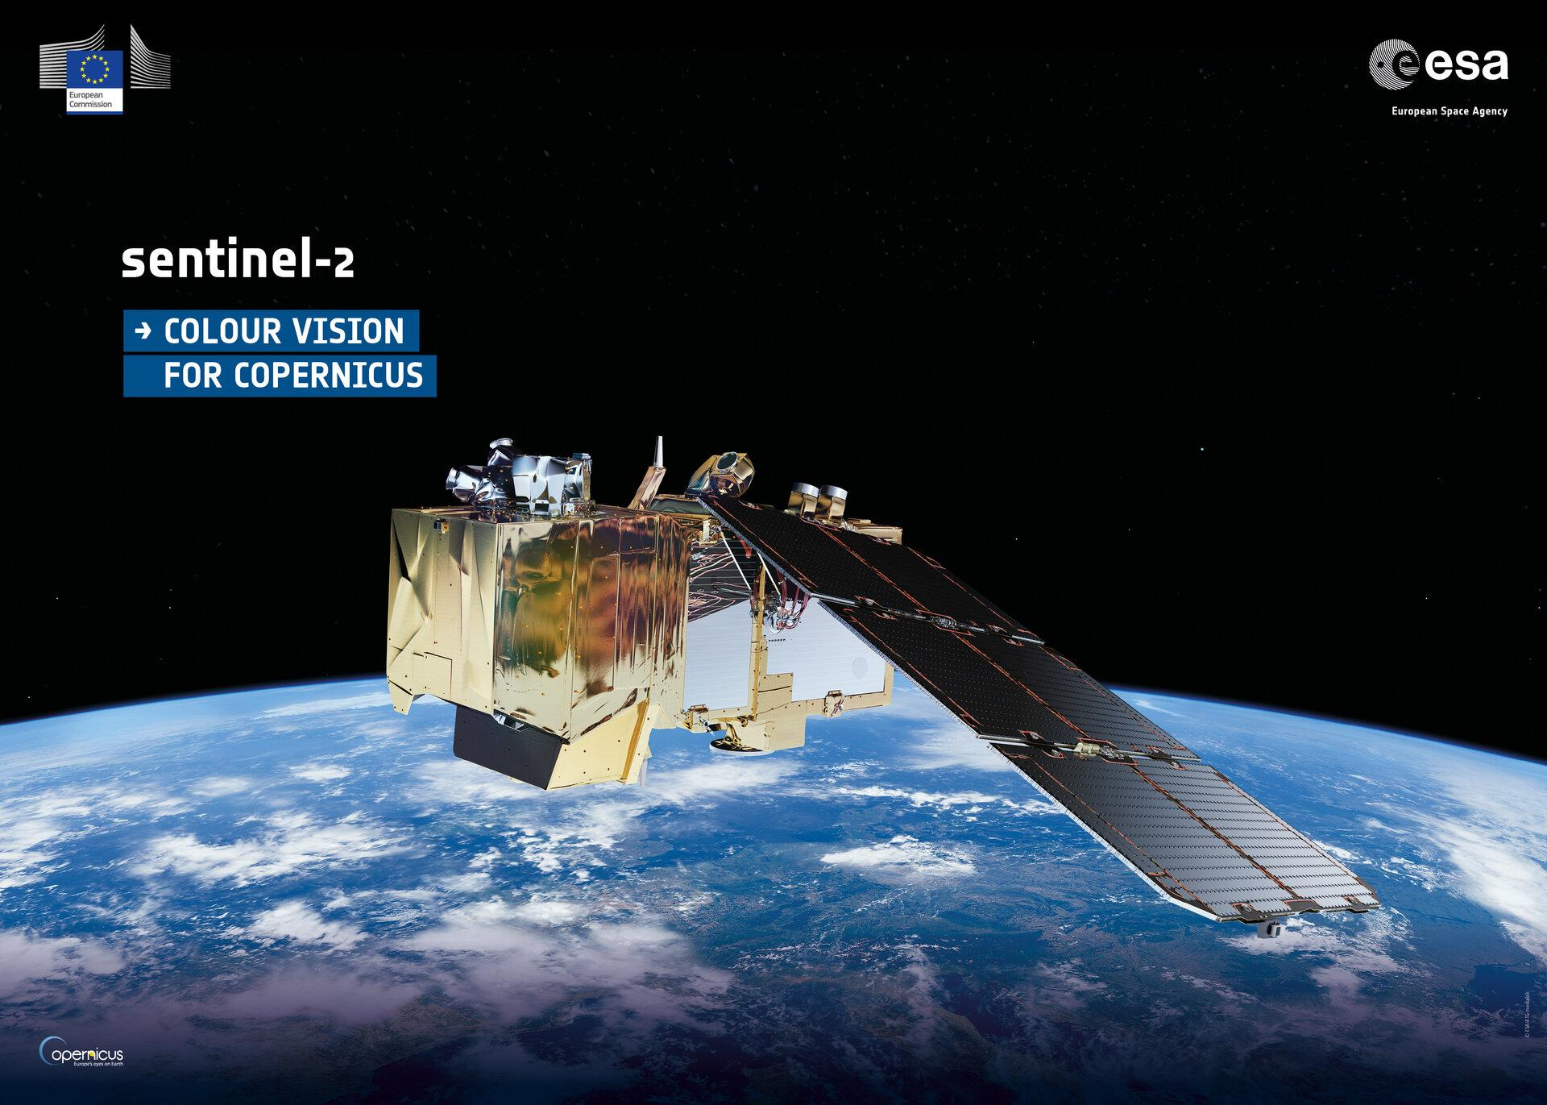
Introduction
Remote Sensing technologies can limit the monitoring costs and provide frequently updated spatially continuous data that facilitate mapping and analysis of water bodies
Remote Sensing can represent a viable and low-cost solution for a continuous and long-term monitoring of fundamental reservoir parameters such as water volume/area/level
HPC4RM - ESA Living Planet 2022
Earth Observation Big Data exploitation for water reservoirs continuous monitoring: feasibility of a prototypal service based on Sentinel data and HPC

Slide 5
HPC4RM project - HPC for Reservoir Management
Identifier: FF4EuroHPC Call-2
Call title: First call for FF4EuroHPC application experiments
Project full name: FF4EuroHPC: HPC Innovation for European SMEs
Acronym: FF4EuroHPC
Identifier: 1113
Acronym: HPC4RM
Project full name: HPC for Reservoir Management
HPC4RM - ESA Living Planet 2022
Earth Observation Big Data exploitation for water reservoirs continuous monitoring: feasibility of a prototypal service based on Sentinel data and HPC

Slide 6
Project Organizations
Service Provider
will take advantage of its experience in the creation of specialized software and services for satellite data processing to define and develop the foreseen application to provide new service by using HPC assets
Domain Expert
will provide insights and expertise in optical image processing and advanced geomatic methodologies and techniques to help the design of the overall application and to tailor the processing step in the workflow
HPC Expert / Centre
will support the definition of the best strategies for efficient exploitation of HPC capabilities and support the development of the proposed solution
End User
will provide access to all the needed information of their reservoirs, targeted by the experiment; they will drive the definition of the real needs of end-users and assess the result of the experiment
HPC4RM - ESA Living Planet 2022
Earth Observation Big Data exploitation for water reservoirs continuous monitoring: feasibility of a prototypal service based on Sentinel data and HPC

Slide 7
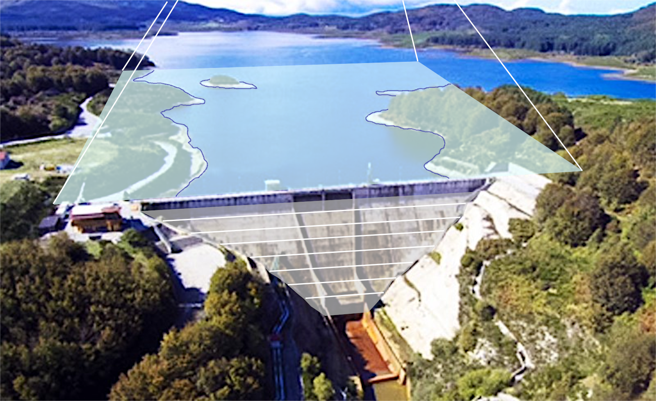
HPC4RM project - HPC for Reservoir Management
Satellite data will play a key-role in enabling a continuous monitoring service over time at a negligible cost, as continuous (i.e., every few days) monitoring is in place, giving new insights to water resource managers on their assets
HPC4RM experiment will allow designing a new service that takes advantage of HPC to build an evolving 3D model of the reservoir through the integration of the planimetric water extent, estimated from AI super-resolved Sentinel-2 imagery, with local information on water level
HPC4RM - ESA Living Planet 2022
Earth Observation Big Data exploitation for water reservoirs continuous monitoring: feasibility of a prototypal service based on Sentinel data and HPC

Slide 8
HPC4RM project - HPC for Reservoir Management
The goal the project is strictly related to United Nations Sustainable Development Goals (SDGs) related to water availability (SDG 6) and climate change effect monitoring (SDG 13) and with the Recovery Plan Next Generation EU
HPC4RM - ESA Living Planet 2022
Earth Observation Big Data exploitation for water reservoirs continuous monitoring: feasibility of a prototypal service based on Sentinel data and HPC

Slide 9
Methodology
The proposed methodology implements the following main steps:
Artificial Intelligence (AI) powered super resolution of Sentinel-2 imagery
Detection of the (2D) extent of the reservoirs from the super resolved Sentinel-2 imagery
Computation of 3D volumetric changes by integrating the computed water surface extent with local information on the water level
HPC4RM - ESA Living Planet 2022
Earth Observation Big Data exploitation for water reservoirs continuous monitoring: feasibility of a prototypal service based on Sentinel data and HPC

Slide 10
AI powered super resolution
The goal of super-resolution is to take a low resolution image I0 and upsampling factor t, and generate a corresponding high resolution version I
We follow the deep image prior approach to provide a super-resolution algorithm that does NOT depend on the availability of training datasets
The main disadvantage of the proposed approach is that, while avoiding any training phase, the actual super resolution step can be regarded as a training phase itself, with a similar (high) computational cost
The availability of HPC premises (in particular, GPU HW), is mandatory to allow any practical implementation of the deep image prior super resolution approach on the Sentinel-2 imagery
HPC4RM - ESA Living Planet 2022
Earth Observation Big Data exploitation for water reservoirs continuous monitoring: feasibility of a prototypal service based on Sentinel data and HPC

Slide 11
Detection of the extent of the reservoirs
Two different methods to detect the horizontal extent of the reservoirs, originally developed for Landsat imagery, were investigated to segment the pixels that belong to water areas:
Method 1 relies on the use of the Automatic Water Extraction Index (applied on the atmospherically corrected surface reflectance values) and on a non-parametric unsupervised method based on the Canny edge filter and Otsu thresholding (Donchyts et al 2016), (Sengupta et al 2020)
Method 2 generates false color composites starting from the Short-wave infrared (SWIR1)/NIR/Red bands of Landsat images and then applies a HSV transformation (Valadão et al, 2021)
HPC4RM - ESA Living Planet 2022
Earth Observation Big Data exploitation for water reservoirs continuous monitoring: feasibility of a prototypal service based on Sentinel data and HPC

Slide 12
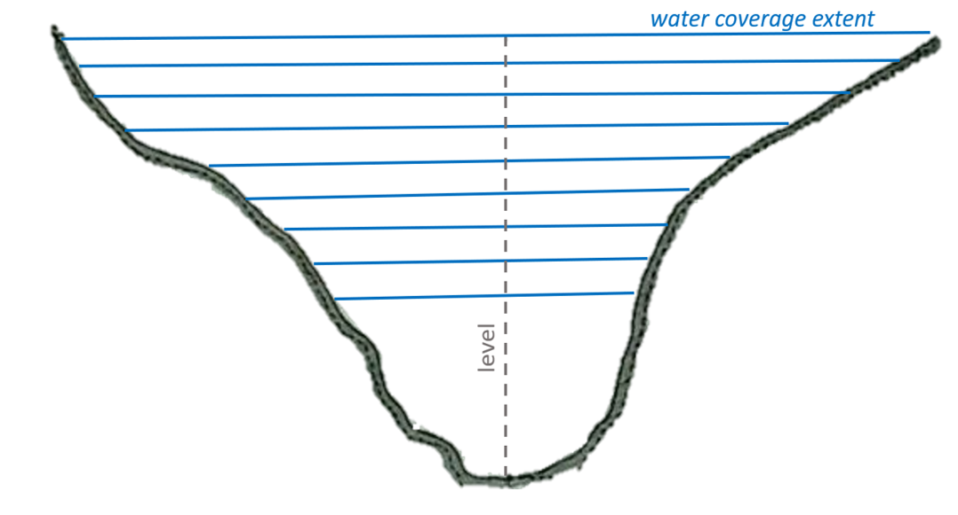
Computation of 3D volumetric changes
The 3D volumetric changes will be computed by integrating the information of in-situ measured water level with the corresponding estimated water surface extent
The seasonal variations of the reservoir water storage allow defining a volumetric 3D model of the reservoir: the varying water level acts as a layer stripping procedure
The ability to map the time variations of the shallower areas of the reservoir plays a key role in reservoir and water resources management
Relation between estimated water coverage exent and reservoir filling level (shown for a selected reservoir cross-section)
HPC4RM - ESA Living Planet 2022
Earth Observation Big Data exploitation for water reservoirs continuous monitoring: feasibility of a prototypal service based on Sentinel data and HPC

Slide 13
Case studies
Two different reservoirs in the south of Italy (Calabria region) providing the freshwater supply for nearly two million people:
Menta dam lake with a total volume of 17.9 hm³
Alaco dam lake with a total volume of 32 hm³
characterized by quite different environments and average shore steepness
Local water level data are provided by Società Risorse Idriche Calabresi S.p.a. (So.Ri.Cal.)
HPC4RM - ESA Living Planet 2022
Earth Observation Big Data exploitation for water reservoirs continuous monitoring: feasibility of a prototypal service based on Sentinel data and HPC

Slide 14
HPC4RM: S2A image examples
Bands: 4,3,2 (red, green, blue)
Bands: 8,4,3 (near infrared, red, green)
Diga del Menta: Jan 4th, 2022
HPC4RM - ESA Living Planet 2022
Earth Observation Big Data exploitation for water reservoirs continuous monitoring: feasibility of a prototypal service based on Sentinel data and HPC

Slide 15
HPC4RM: S2A image examples
Bands: 4,3,2 (red, green, blue)
Bands: 8,4,3 (near infrared, red, green)
Diga del Menta: Aug 17th, 2020
HPC4RM - ESA Living Planet 2022
Earth Observation Big Data exploitation for water reservoirs continuous monitoring: feasibility of a prototypal service based on Sentinel data and HPC

Slide 16
HPC4RM: S2A image examples
Bands: 4,3,2 (red, green, blue)
Bands: 8,4,3 (near infrared, red, green)
Diga del Menta: Aug 20th, 2020
HPC4RM - ESA Living Planet 2022
Earth Observation Big Data exploitation for water reservoirs continuous monitoring: feasibility of a prototypal service based on Sentinel data and HPC

Slide 17
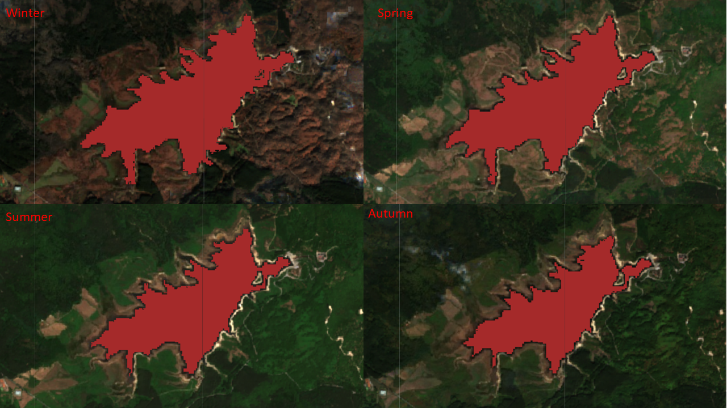
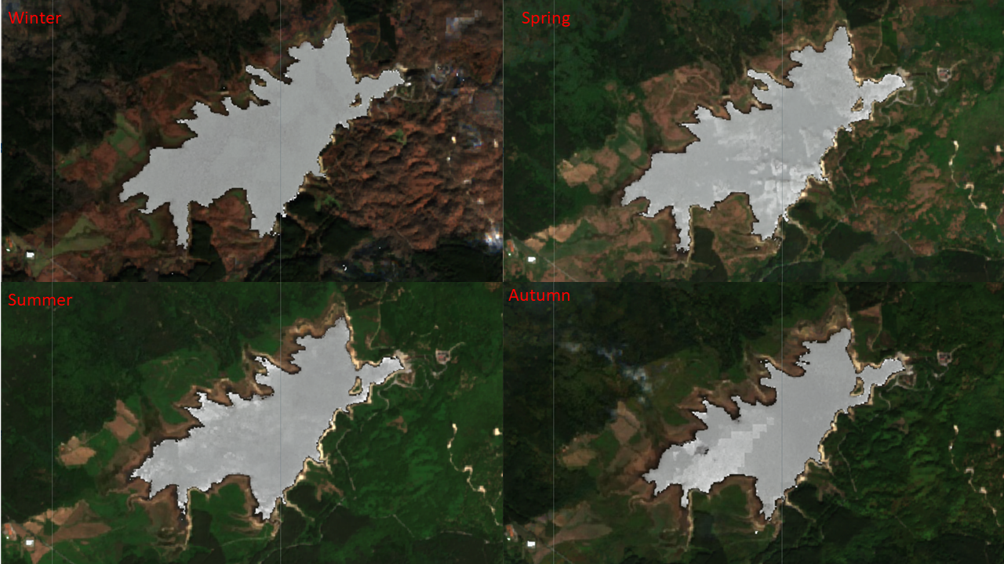
Results - Alaco dam lake
All the images of Sentinel-2 available for for the year 2021 were filtered by selecting the ones with the lowest cloud coverage and masking out the remaining cloudy pixels
A total of 4 images, one for every three months of the considered period, were obtained by computing the median values of the pixels from the filtered set of images
The two methods for the water extent detection were applied to each of the four images
Results of the detection of the water extent (spectral index based) for the 2021 year - method 1
Results of the detection of the water extent for the second (HSV based) method for the 2021 year - method 2
HPC4RM - ESA Living Planet 2022
Earth Observation Big Data exploitation for water reservoirs continuous monitoring: feasibility of a prototypal service based on Sentinel data and HPC

Slide 18
Conclusions
Water shortage and long periods of droughts interspersed with extreme weather events make the correct management of water resources a critical issue
The continuous monitoring of water reservoirs can be performed by satellite data without the need for direct access to reservoir sites and with an overall cost that is independent of the actual extent of the reservoir
A complete data processing chain is currently under development, starting from satellite raw data up to water body detection and surface extent estimation
The use of AI-powered super-resolution techniques will allow achieving the required resolution starting from the ESA Sentinel-2 constellation
HPC4RM - ESA Living Planet 2022
Earth Observation Big Data exploitation for water reservoirs continuous monitoring: feasibility of a prototypal service based on Sentinel data and HPC

Slide 19
Thank you for your attention
HPC4RM - HPC for Reservoir Management
www.ff4eurohpc.eu/en/experiments/2022031511555138/hpc_for_reservoir_monitoring
HPC4RM - ESA Living Planet 2022
Earth Observation Big Data exploitation for water reservoirs continuous monitoring: feasibility of a prototypal service based on Sentinel data and HPC

Slide 20
Project Schedule
Task
1. Coordination & Dissemination
2. HPC & Overall System Definition
3. Experiment Preparation
4. Exp. Execution & Monitoring
5. Exp. Validation
Mar | Apr | May | Jun | Jul | Aug | Sep | Oct | Nov | Dec | Jan | Feb | Mar | Apr | May
At first, experiment partners will define the best suited HPC resource exploitation (Task 2) and overall design of the processing chain and data management (Task 3). Then the proposed solution will be set up and tailored to monitor the targeted reservoirs as identified by the end-user SORICAL (Task 4). Finally, the obtained results will be validated against experiment objectives to assess the successful performance of the experiment (Task 5).
Nonetheless, all partners will disseminate all along the project execution the experiment objectives, results and advantages of HPC exploitation (Task 1).

Slide 21
HPC4RM: Super Resolution by Deep Image Prior
bicubic
ground truth
deep image prior
http://www.lenna.org/
HPC4RM - ESA Living Planet 2022
Earth Observation Big Data exploitation for water reservoirs continuous monitoring: feasibility of a prototypal service based on Sentinel data and HPC

Slide 22
Project WBS
HPC4RM
Coordination & Dissemination
GGD-DICEA
SORICAL
CINECA
HPC System definition
ARESYS
ARESYS
CINECA
Mar 22 – May 23
Mar 22 – May 22
Exp. Preparation
GGD-DICEA
SORICAL
ARESYS
Mar 22 – Aug 22
Exp. Execution
GGD-DICEA
SORICAL
CINECA
ARESYS
Aug 22 – Apr 23
Exp. Validation
ARESYS
SORICAL
GGD-DICEA
Mar 23 – May 23

Slide 23
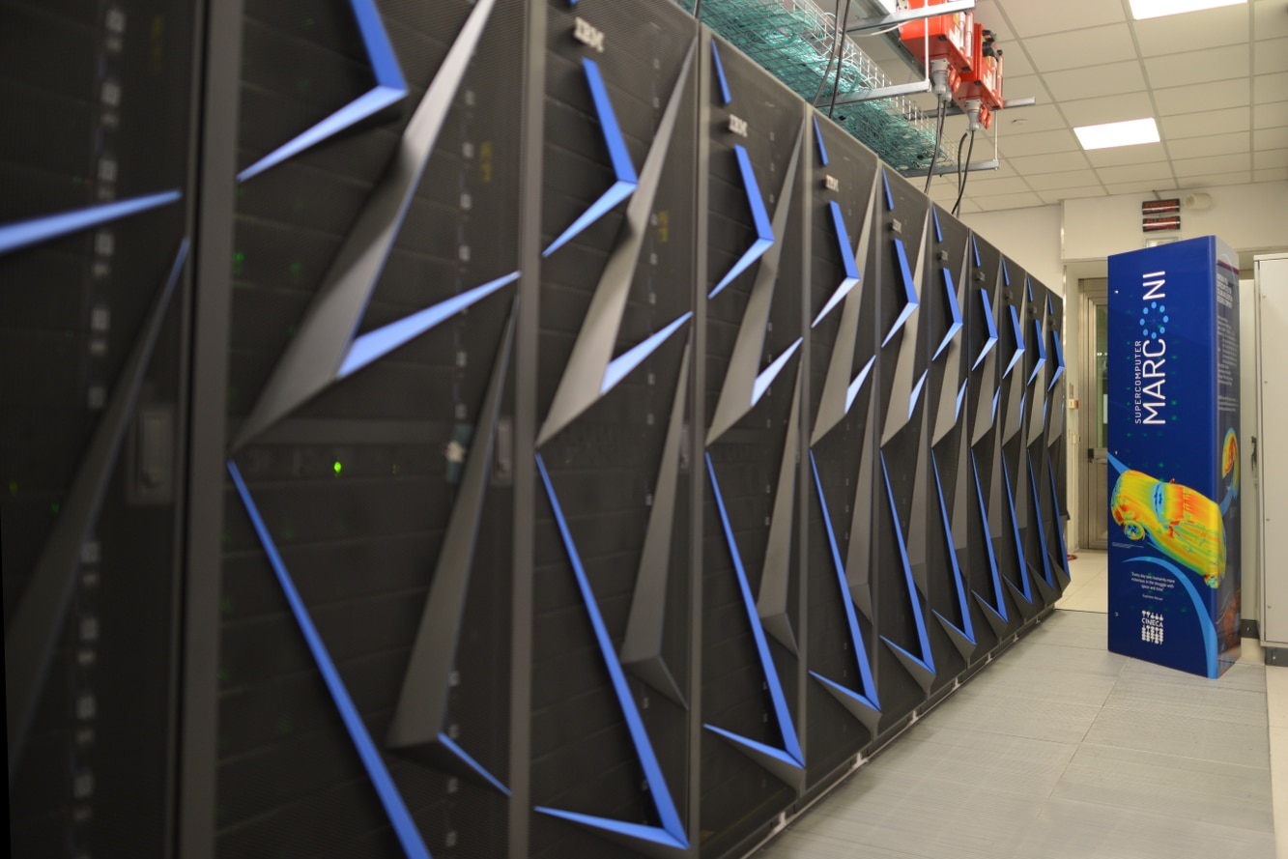
Processing Environment
Two different HPC architectures, available at CINECA premises, will be used in the deployment and testing of HPC4RM processing solution:
GALILEO100: 554 computing nodes each 2 x CPU Intel CascadeLake 8260, with 24 cores each, 2.4 GHz, and 384GB RAM;
MARCONI100: 980 computing nodes each 2 x IBM POWER9 AC922 with 16 core each, 2.6 GHz, 256GB RAM. Each node is equipped with 4 x NVIDIA Volta V100 GPUs, Nvlink 2.0, 16GB.

Slide 24
Project Deliverables
months
Task | Deliverable
1. Coordination | D1.1 Project Management Plan
 | D1.2 Progress Meeting Reports
 | D1.3 Business & Exploitation Plans
 | D1.4 Final Experiment Report
2. System Definiton | D2.1 HPC Architecture Exploitation Document
3. Exp, Preparation | D3.1 Software Design Document
4. Exp. Execution | D4.1 HPC enabled software application
5. Exp. Validation | D5.1 Validation report
1 | 2 | 3 | 4 | 5 | 6 | 7 | 8 | 9 | 10 | 11 | 12 | 13 | 14 | 15

Slide 25
PMP: communication plan
All meetings will be held online
Official language for all documents: UK English
Official language for coordination with ff4EuroHPC: UK English
Preferred language for informal communication: Italian
Preferred form for Informal communication: written communication via specific MS Teams

Slide 26
PMP: risk analysis

Slide 27
HPC4RM: work logic
At first, experiment partners will define the best suited HPC resource exploitation (Task 2) and overall design of the processing chain and data management (Task 3). Then the proposed solution will be set up and tailored to monitor the targeted reservoirs as identified by the end-user SORICAL (Task 4). Finally, the obtained results will be validated against experiment objectives to assess the successful performance of the experiment (Task 5).
Nonetheless, all partners will disseminate all along the project execution the experiment objectives, results and advantages of HPC exploitation (Task 1).

Slide 28
HPC4RM Kick Off
Final remarks

